Slide 1
SECURE DATA HIDING IN IMAGES USING STEGANOGRAPHY
CAPSTONE PROJECT
Presented By: Sowbathi Balasubramani
Student Name : Sowbathi Balasubramani
College Name & Department : Erode Sengunthar Engineering College & Mechanical Department

Slide 2
OUTLINE
Problem Statement
Technology used
Wow factor
End users
Result
Conclusion
Git-hub Link
Future scope

Slide 3
Problem Statement
Traditional encryption techniques provide robust data security; however, they often attract the attention of potential attackers, increasing the risk of interception.
This project seeks to develop an advanced image-based steganography method for embedding confidential information within digital images while preserving visual quality and minimizing the likelihood of detection.
The primary challenge lies in optimizing data concealment while enhancing resilience against steganalysis attacks, ensuring both security and imperceptibility.

Slide 4
Technology used
OpenCV (cv2)
Used for image processing and manipulation.
OS Module (os)
Provides functions for interacting with the operating system.
Python Standard Libraries:
string: Although imported, it's not used in the given code.
Dictionary (dict): Used for mapping ASCII characters to pixel values and vice versa.
Loops & Conditional Statements: Implements the logic for encoding and decoding messages.
Platforms & Execution Environment:
Operating System: Windows 10
Python Interpreter: Python 3.x
IDE/Editor: Python IDLE

Slide 5
Wow factors
Simple Yet Effective Steganography Implementation
Use of OpenCV for Image Manipulation
Lightweight and Fast Execution
Custom Passcode-Based Authentication
Fully Offline Encryption & Decryption
Platform Independence (Runs on Any Python-Compatible System)
Easy to Expand & Upgrade
Fun & Educational Value

Slide 6
End users
Cybersecurity Professionals & Ethical Hackers
Security experts exploring covert communication techniques and data protection strategies.
Ethical hackers testing the resilience of steganographic systems against detection and extraction methods.
Government & Intelligence Agencies
Military and defense units employing covert messaging for classified communications in sensitive operations.
Law enforcement and intelligence organizations requiring secure data transmission without raising suspicion.
Investigative Journalists & Whistleblowers
Journalists handling sensitive information that needs to be shared securely without being intercepted.
Whistleblowers seeking a discreet method to communicate confidential reports while avoiding surveillance.
Digital Forensics & Law Enforcement Agencies
Forensic analysts investigating hidden data within digital media to uncover potential cybercrimes.
Privacy Advocates & Digital Rights Activists
Individuals advocating for data privacy, anonymity, and protection against surveillance.
Civil rights organizations ensuring secure communication for individuals in high-risk environments.

Slide 7
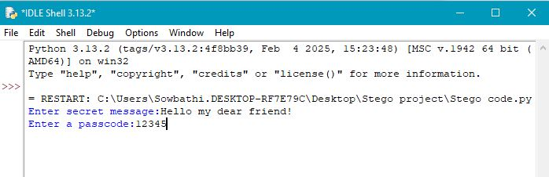
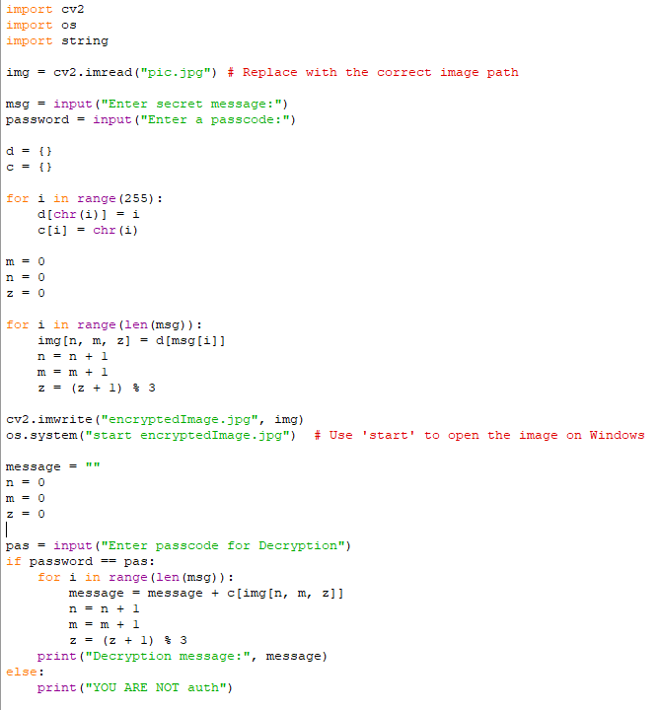
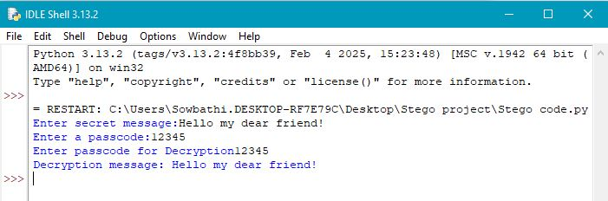


Results

Slide 8
Conclusion
This image-based steganography project provides a secure and efficient method for embedding confidential messages within digital images.
By integrating OpenCV for image processing and passcode-based authentication, it enhances data security while maintaining visual integrity.
With applications in cybersecurity, intelligence, and digital forensics, this project serves as a foundation for advanced covert communication systems.
Future improvements, such as enhanced encryption and AI-driven steganalysis resistance, can further strengthen its effectiveness in secure data transmission.

Slide 9
GitHub Link
https://github.com/Sowbathi/MyStego.git

Slide 10
Future scope(optional)
Enhanced Encryption – Integrate AES/RSA encryption for stronger security.
AI-Powered Steganography – Use machine learning to optimize data hiding and evade detection.
Increased Data Capacity – Implement LSB with multi-channel embedding for larger messages.
Video & Audio Steganography – Extend to multimedia files for real-time covert communication.
Blockchain Integration – Use blockchain for tamper-proof verification of hidden data.
Cloud-Based Security – Develop cloud platforms for encrypted data sharing.
Mobile & Cross-Platform Support – Create Android, iOS, and web apps for easy access.

Slide 11
THANK YOU

